Slide 1
The International Student Experience: Supporting First Year Transition
July 27, 2011
Berkeley International Office

Slide 2
Today’s Agenda
Outcomes
International Student Population
Berkeley International Office
Student Concerns
Transition Support Programs

Slide 3
Outcomes
Enhance awareness of transitional issues and common concerns of Berkeley's international student population
Share resources for supporting international students in transition
Promote an inclusive environment for advising and supporting international students

Slide 4

Berkeley
INTERNATIONAL STUDENTS ENROLLMENT
INTERNATIONAL
OFFICE
Source: University of California / Berkeley International Office (BIO)

Slide 5
2010 Enrollment and
Anticipated 2011 Enrollment

Slide 6
Top 5 Countries Represented in New
Degree Seeking Undergraduate Students

Slide 7
Top 5 Countries Represented in New
Degree Seeking Graduate Students

Slide 8
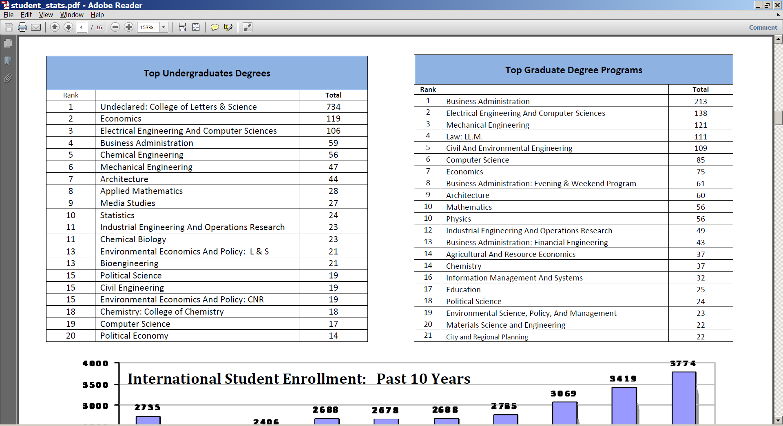
Fields of Study

Slide 9
Berkeley International Office’s Role

Slide 10
BIO Services for All International Students
Individual Daily Drop-Ins & Appointments
Fall & Spring Orientations
Academic & personal adjustment
Financial issues
Campus Policies
Visa related matters
Employment Benefits
Group Advising Sessions

Slide 11
BIO Services for Campus Staff
BIO’s responsibilities
  Department and college specific trainings
  Professional development workshops
  Phone, email, and web support
  Campus liaisons
Notes:
Support campus staff in advising international students through department and college specific trainings
Promote professional development through regular workshops
Campus liaisons with key campus units

Slide 12
Collaboration Across Campus
Student Learning Center
New Student Services
Transfer Center
Counseling & Psychological Services
Career Center
Student Advocate Office
I House
Student Organizations
ASUC
Graduate Division Academic Services
College Advising Units
University Housing
Admissions Office
Study Abroad Office
Career Counseling Library
Financial Aid Office
Payroll Office

Slide 13
Staff Workshops
Hiring & Paying UC Berkeley International Students On Campus
Tuesday, August 2 1-2:30
International Student Needs Assessment: Results & Implications
Tuesday, August 9 1-2:30

Slide 14
Student Concerns

Slide 15
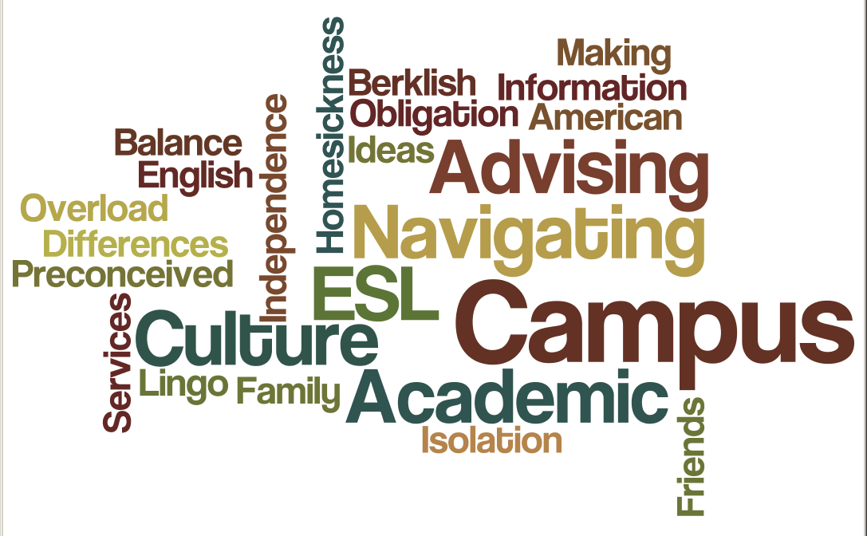

Slide 16
International Student Concerns
Financial Support
Employment
Balance
Communication
Academic Rigor

Slide 17
Transfer Student Concerns
Campus Culture Shock
Impacted Majors
Military Service
Social Network
Notes:
Academic rigour, bigger campus, more people to interact with, no one stop shop

Slide 18
BIO Transition Support Programs
Notes:
To assist international students in their transition, we’ve created a variety of programs that cover the following themes that we believe are important for an overall successful transition…

Slide 19
BIO Transition Programming
  Orientation: Navigate campus, social connections, academic expectations
  Cultural Adjustment: US, campus, classroom
  Personal Adjustment: Establishing social network, self-awareness, setting goals
  Academic Success: Faculty expectations, American writing conventions, finding balance
  Dependent Support: Adjustment, social networks, accessing benefits
Notes:
These are all themes that can be found in the programs we offer throughout the year as well as in our orientation.
-e.g. For the theme on personal adjustment, we offer a workshop w/ CPS called the Well-Rounded Bear that helps to increase one’s self awareness and teaches them to set goals for themsevles
Theme on academic success – we teamed up w/ SLC and Student Conduct Office to do a workshop on Writing American Style to give tips on how to write an academic paper and not plagiarize.

Slide 20
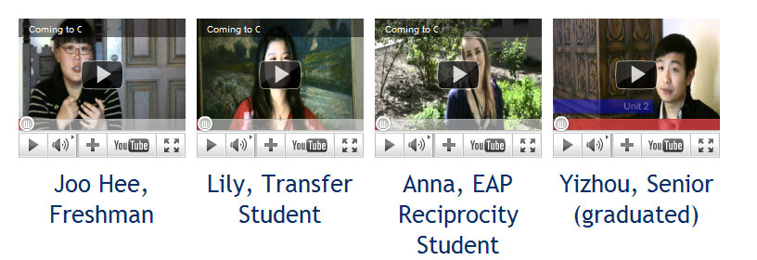
Pre-Arrival Support
Berkeley International Buddies & Facebook
Student & Advisor Welcome Videos
Friday News
Community College Outreach for New Admits
Notes:
We also looked at how we offer support and decided to break out a student’s transition into 3 phases so that the delivery of information is better targeted and easier to retain instead of getting overwhelmed with information. The 3 phases are pre-arrival, arrival, and post-arrival.
BIB: 270 current students matched with 400 new students. Created in response to students asking for something like this.
Facebook – creating a social network even before coming
Student videos – acclimate students before they come and get them excited about coming
Advisor video – welcome students, give us a face.
Special Friday News that will have weekly topics of interest for new students e.g. Q&A Paying your bills at Cal

Slide 21
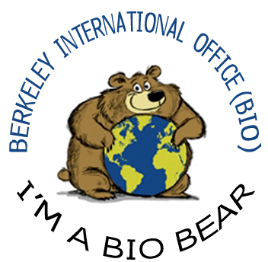
Arrival Support
Early Arrival Housing
Check In Meetings (Mandatory)
Volunteer Led Social Activities
Orientation Program
Welcome Week Activities
Notes:
Early Arrival Housing – sold out and arranged for students who arrive before the dorms open so they can come to orientation
Check-ins: identifying campus resources, getting Cal1 card, SSN, DMV
Volunteer led social activities – something to do since they’re here early
Orientation – other special topics academic success, culture shock, getting around Bay Area
Welcome Week activities – BIB meet up, EAP meet up, accent reduction

Slide 22
International Orientation Week
Sun 14 | Mon 15 | Tues 16 | Wed 17 | Thurs 18 | Fri 19 | Sat 20
Frosh & Transfer Welcome & Pizza Party 5-8pm | Freshman Orientation 8-2pm Parent Orientation 1-2:30pm EAP Orientation & Pizza Party 3:30-7pm | Transfer Orientation 8-12:30pm Grad Orientation & Pizza Party 2-7pm | Combined Orientation 9-12pm Culture Shock 7-9pm | Check Ins | Resource Fair 2-4pm Ice Cream Social 4:30-6pm | Volunteer Led Tours & Activities

Slide 23
Post Arrival
International Student Experience Course: Pathways to Personal & Academic Success
Dependent Orientation
Workshop Series:
  Academic Success
  Transfer Student Success
  Financial Health
  My American Work Experience
  US Culture Series
  Student Perspectives
Notes:
Looking down the line on what other information we can provide and support after their arrival.

Slide 24
Student Panel

Slide 25
Student Panelists
Jerry (Jiaxi) Zhu
Sophomore, Mechanical Engineering
China
Jyothi Krishnan
Doctorate, Mechanical Engineering
India
Kate (Yaehyun) Kang
Senior, Development Studies
South Korea

