Slide 1
Supporting International Students:
An Overview of the Most Common Requests
Berkeley International Office

Slide 2
Today’s Agenda
Intended outcomes
International students at Berkeley
Overview of common requests
Notes:
Mention that we are talking just about F-1, and J-1 students and not covering other visa types, or scholars

Slide 3
Most Common Request Forms
Reduced Course Load (RCL) – 171
Curricular Practical Training (CPT) – 472
Optional Practical Training (OPT) – 541
Extension of Program - 266

Slide 4
Outcomes
To learn about the most common types of BIO request forms that require campus advisors’ endorsements
To understand the campus advisor’s role in recommending these benefits
To understand BIO’s role in recommending and authorizing students’ requests

Slide 5
International Students at Berkeley

Slide 6
Who are our International Students?
Primary objective: full-time study and intent to return home
F-1 Students
(Department of Homeland Security)
J-1 Students
(Department of State)
83.7% of population
Degree students
Funding
  at least one year of funding
11.8% of population
Degree & Exchange Students
Funding
  length of program
  51% or more must come from external source
Notes:
Clarify that F-1 students don’t have restriction of source of funds, J-1 students: example – Fulbright, UCB, can’t be personal funds.
6

Slide 7


Introducing….Fei & James
Fei is an F-1 Student
James is a J-1 Student
Notes:
Introduce Fei and James as our fictional international students that will help walk us through examples of the forms.

Slide 8
Reduced Enrollment

Slide 9
Reduced Enrollment Requests
International students are required to be enrolled full-time during the regular, academic year
Exceptions:
  Final semester – students in their final semester who need less than full-time units to graduate
  Academic reasons – academic recommendation for why full-time enrollment would not be appropriate
  Health reasons – medical recommendation from MD, doctor of osteopathy or licensed clinical psychologist
Notes:
It’s the first semester for both Fei and James….
Fei’s stuggling academically because she learns enrolled in a course and has not met the prequisite. (improper course level placement)
James isn’t used to the format of some of his classes. They’re heavily discussion based and he’s accustomed to lecture style classes and is feeling overwhelmed. (unfamiliarity w/Am teaching methods)

Slide 10
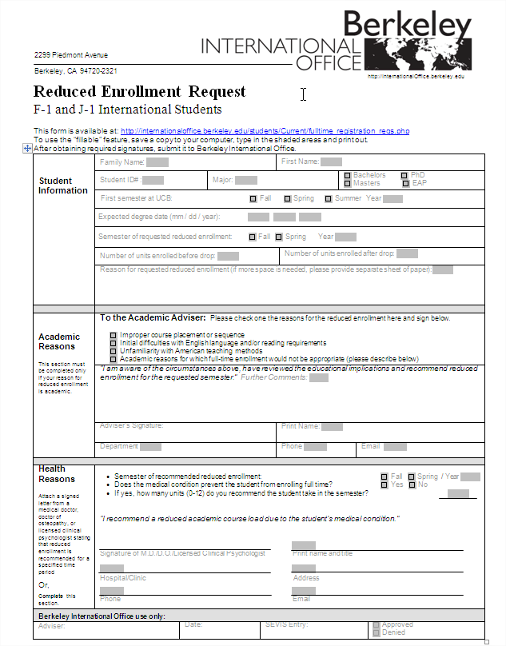
Reduced Enrollment Request Form
Notes:
Outline in black

Slide 11
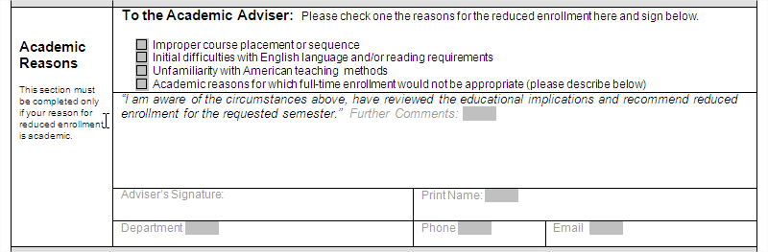
Reduced Enrollment Request Form
Provide academic reasons for recommending the student to drop below full-time units.
Notes:
Here is where you indicate which reason. For Fei, it’s appropriate to check-off “improper course level placement”, for James, “unfamiliarity with American teaching methods”

Slide 12
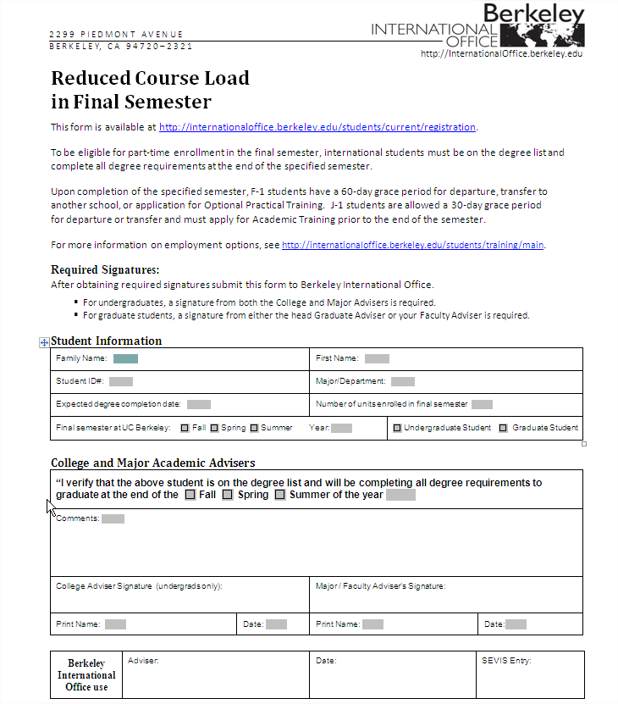
Notice of Final
Semester Form
Notes:
All students are eligible to take less than F/T in final semester, but we need this form

Slide 13
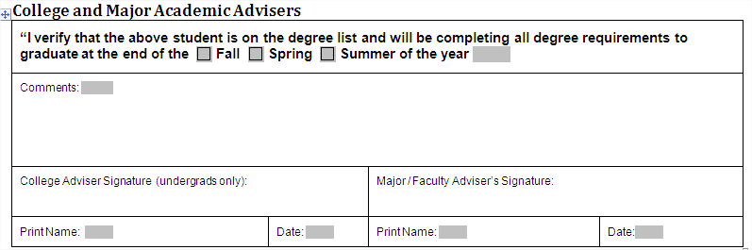
Notice of Final
Semester Form
Confirm student’s final semester and year of expected completion.
Notes:
Confirmation from academic advisors…both college and major. Usually see this form for UG, not grad.

Slide 14
On-Campus Employment Authorization Requests

Slide 15
What is J-1 On-Campus Employment/ Fellowship Authorization?
Authorization required for all on-campus employment
  Employer-specific, any changes to employment requires new authorization (e.g. change in position, department/hiring unit, number of hours)
  Only authorized for up to one year. Authorizations must be renewed annually.
Fellowship Authorization
Notes:
Second semester and both Fei and James are doing well. In fact, they are eager to get an on campus job!

Slide 16
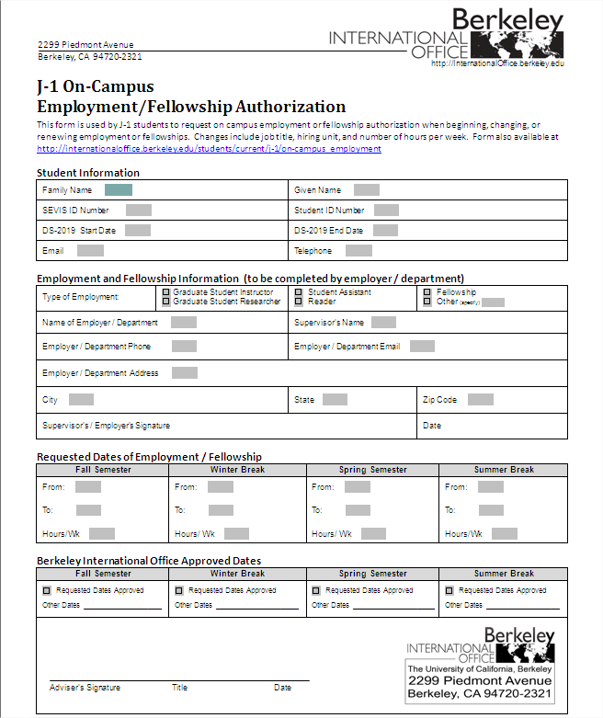
J-1 On-Campus Employment/
Fellowship Authorization Form
Notes:
Outline in black

Slide 17
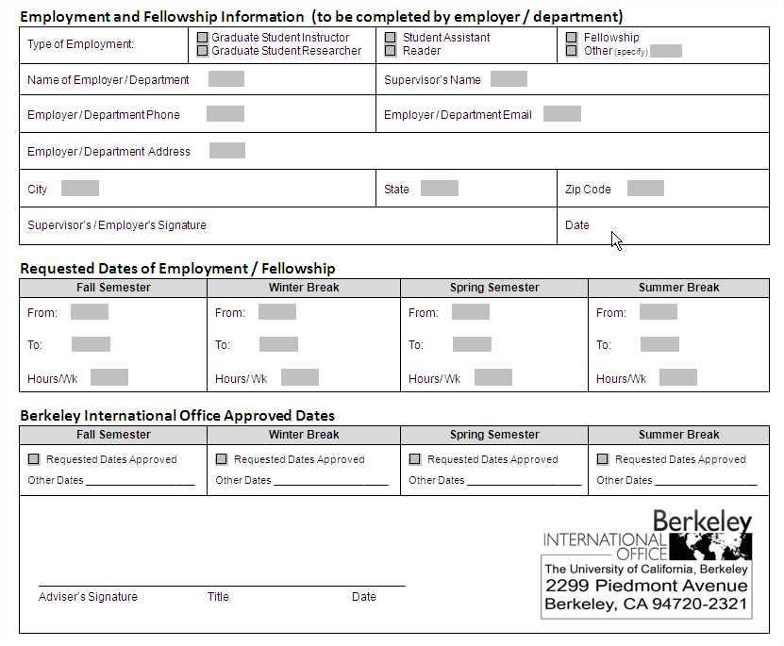
J-1 On-Campus Employment/
Fellowship Authorization Form
BIO Approval
If receiving a fellowship, the awarding department must
input the semester(s) that the student will be receiving the award.
Notes:
Outline in black

Slide 18
F-1 On Campus Employment
No special authorization needed
Social Security Letter
  Template on BIO website
  Letter issued by hiring department
  Endorsed by BIO
  Submitted by student to SSA

Slide 19
Social Security Template Letter
[Use Business Letterhead Stationary]
[Date—current within last 30 days]
To Whom It May Concern:
This letter is to certify that [student’s name] is enrolled as a full-time student pursuing a [degree level] in [major] at the University of California, Berkeley.
[Student’s name] will be working [full-time / part-time] at [name of employer]. [His/her] job will be to [describe job]. [His/her] employment start date is [date].
For additional information, please contact the student’s supervisor, [name of supervisor] at [telephone number].
Sincerely,
[Signature]
[Name of Author]
[Title]
Stamp and Signature of
Berkeley International Office Adviser

Slide 20
F-1 Curricular Practical Training (CPT)

Slide 21
What is F-1 CPT?
Authorization for eligible F-1 students to gain practical experience in their field of study during degree program
Training must be “an integral part of an established curriculum”

Slide 22
How is the job an integral part of a student’s curriculum?
Course credit – elective internship or independent study within a degree program
  Course enrollment must be concurrent with employment
  Granted on a semester-only basis
Degree requirement CPT –
graduation requirement for all students in the program
Notes:
Distinguish b/w American vs. intl students. Americans don’t need course credit because they don’t need work authorization. But since intl students have to get work authorization, this is the way they go about it. By getting course credit, it’s the faculty member that will determine the work, grade, etc. Mention Yao he’s an EECS major, so degree requirement or course credit?
Or students design research project based on internship.
How to determine if internship is “integral part of established curriculum? 1 – degree requirement e.g. Public Health MFE 2- course credit which is most common. Point out that they help to determine how the work is integral and related to their degree program.

Slide 23


Student’s process at the department
Receives
job offer
Works with department to enroll in course & get CPT form signed
Finds faculty to support independent study or internship course
Notes:
*Meets with academic advisor for approval that the job is an “integral part of an established curriculum” and directly related to their degree program. Might also need CCN to enroll.

Slide 24
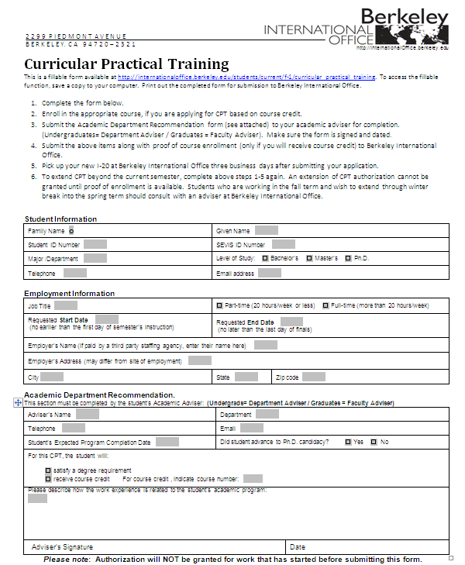
CPT

Slide 25
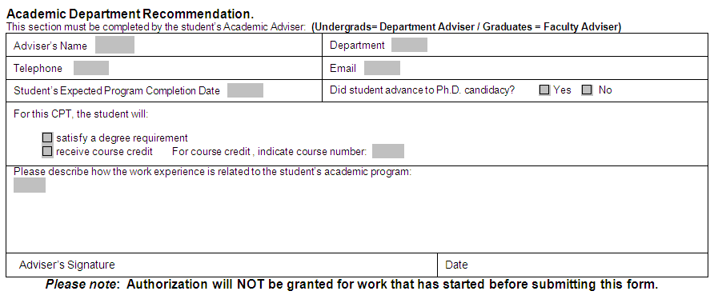
CPT Request –
Academic Recommendation
How is the training an integral part of their established curriculum?
Oski Bear
Electrical Engineering and Computer Science
(510) 642-1818
oski@eecs.berkeley.edu
5/17/2013
x
199
The intern position at Apple will provide Fei with practical experience in Computer Science.
Oski Bear
2/9/2012
How is the training directly related to student’s field of study?
Notes:
Change name to oski

Slide 26
J-1 Academic Training
(Pre-Completion)

Slide 27
What is J-1 Academic Training (AT)?
Available for a period of 18 months or for a period equal to the length of their program, whichever is shorter
Work authorization related to degree program
Employer-specific authorization
Recommended by Academic
Department, authorized by BIO
Notes:
Voice over: Any changes in employment needs new auth. Talk about work authorization in context for Maria – one year EAP eligible for 9 months, she could apply for AT after she completes her first semester.

Slide 28
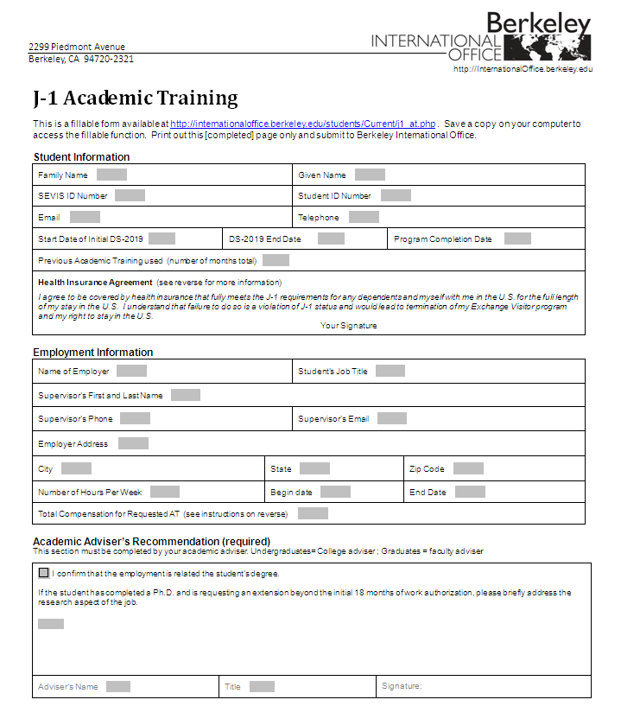
Academic Training
Request Form

Slide 29
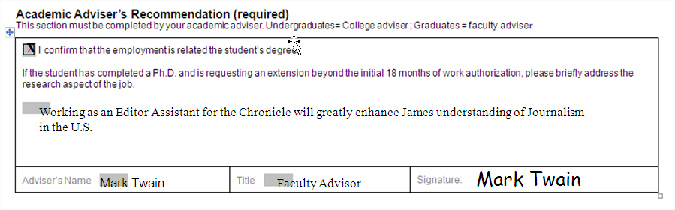
Academic Training Request Form – Academic Recommendation
Check box to confirm student’s employment is related to their degree.

Slide 30
Extension of Program

Slide 31
Extension of Program
If a student is unable to complete their degree program by the program end date indicated on their I-20/DS-2019, they must extend their program with the recommendation of their academic advisor.
Extension of programs can only be given for academic reasons.

Slide 32
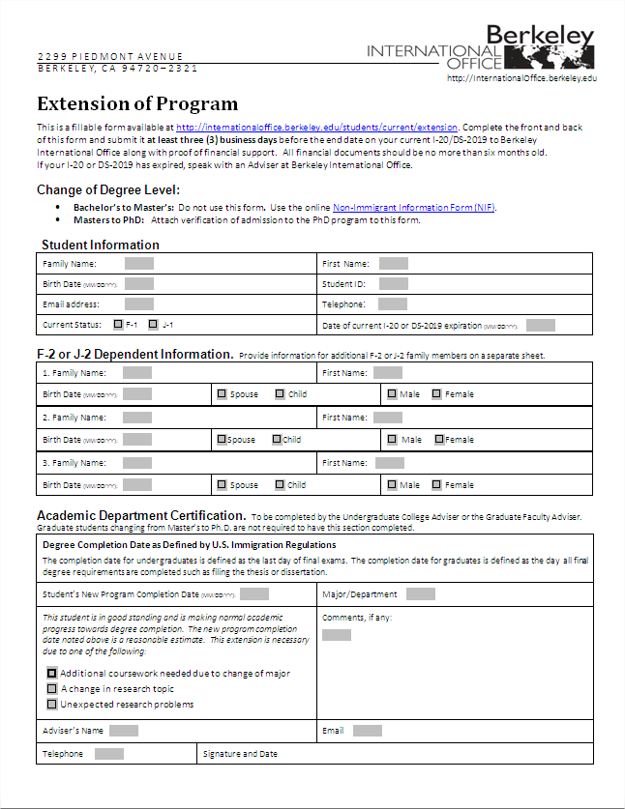
Extension of
Program Form

Slide 33
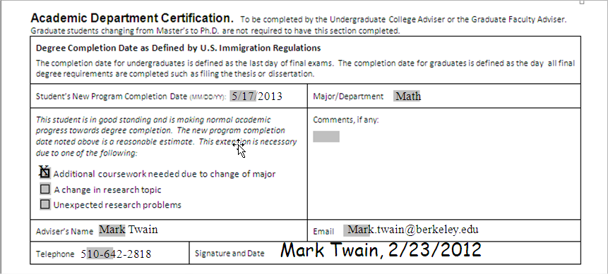
Extension of Program Form– Academic Recommendation
Check off or write in academic reason for the extension.

Slide 34
F-1 Optional Practical Training (OPT)

Slide 35
What is F-1 OPT?
Available for up to 12 months
Department confirms student’s completion date
Recommended by BIO, approved by United States Citizenship and Immigration Services (USCIS)
Employment must be related to field of study
Notes:
Good to reiterate that the job still must be related to degree

Slide 36
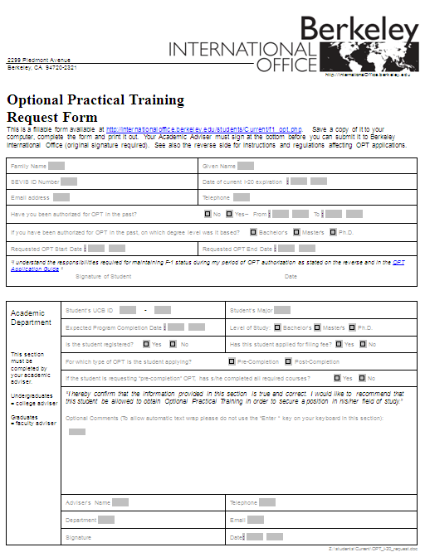
OPT

Slide 37
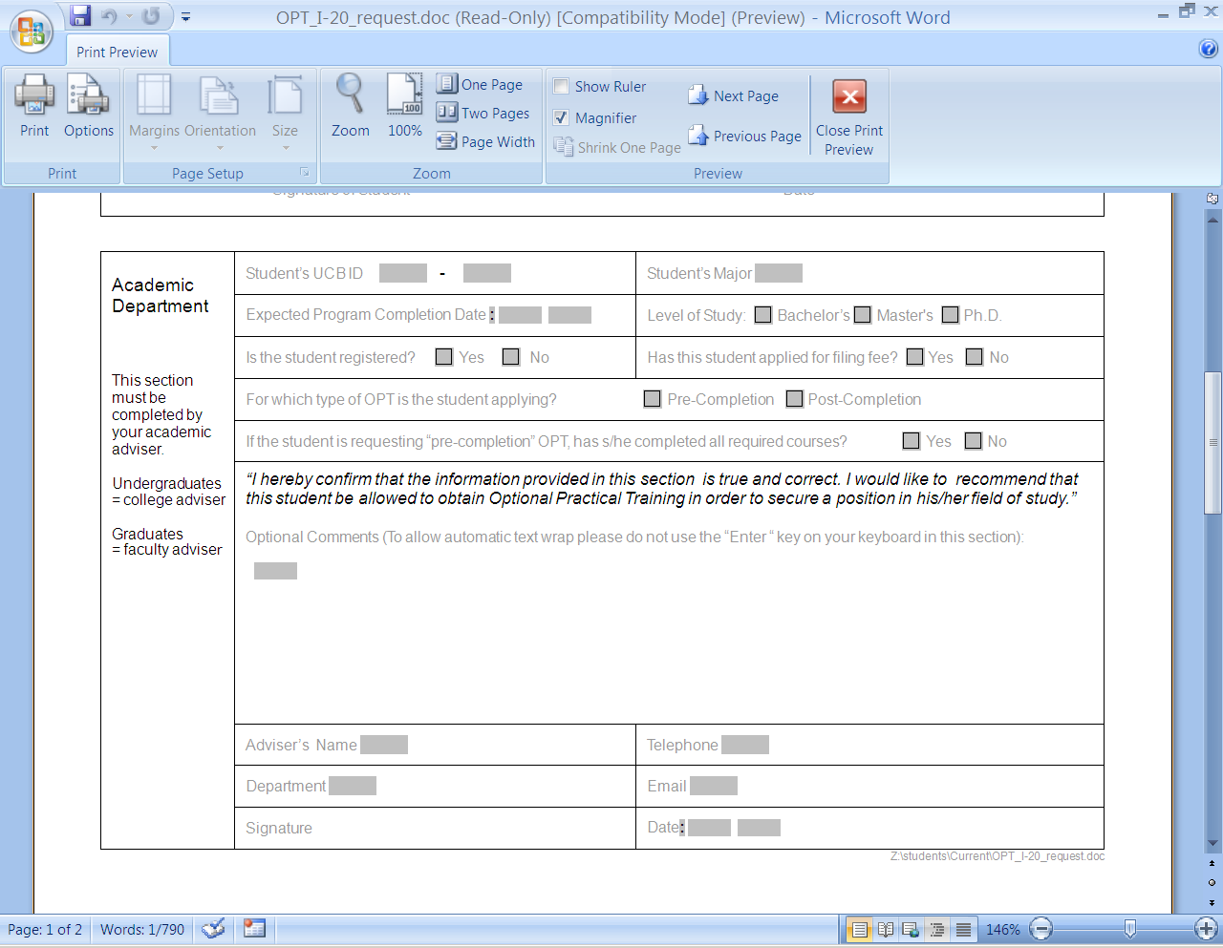
OPT Request –
Academic Recommendation
Department indicates student’s expected program completion date and her current registration status.
1234 5678
Integrative Biology
5/11/2012
x
x
x
x
Albert Einstein
(510) 642-1818
Integrative Biology
einstein@berkeley.edu
Albert Einstein
Your information here and signature.
Notes:
Emphasize prog completion date, point out filing fee check box. Point out flexibility of program completion date for grad students filing thesis. As long as all coursework requirements have been completed, they’re eligible for post-OPT. Filing date should be close to program completion date, but doesn’t have to be exact. Fill out with Raj’s information and highlight box in black

Slide 38
Program Completion Date
For OPT purposes, the completion date is:
Undergraduates
Graduates
Completion date is
last date of final exams
Completion date is
the day thesis or dissertation is filed,
or last day of final
exams
Notes:
Emphasis this point. Mention recent case with student losing OPT benefit due to dept advice
38

Slide 39
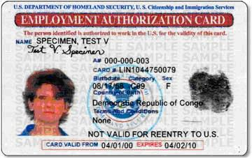

OPT application process
Mail OPT endorsed I-20 and OPT application to USCIS
Fei
Wait 2-3 months….

Slide 40
J-1 Academic Training
(Post-Completion)

Slide 41
Academic Training
(Post-Completion)
For 18 month extensions only, explain research component of student’s job.
Check box to confirm student’s employment is related to their degree.

Slide 42
Withdrawal

Slide 43
Withdrawal
Has implications to legal status in the U.S. when not enrolled.
Students must notify BIO prior to taking action.
BIO will explain F-1/J-1 process of having their record ended and steps to request new visa documents after readmission.
*NEW* BIO Withdrawal form for students to indicate they have officially notified BIO of their withdrawal and to keep as a handout.

Slide 44
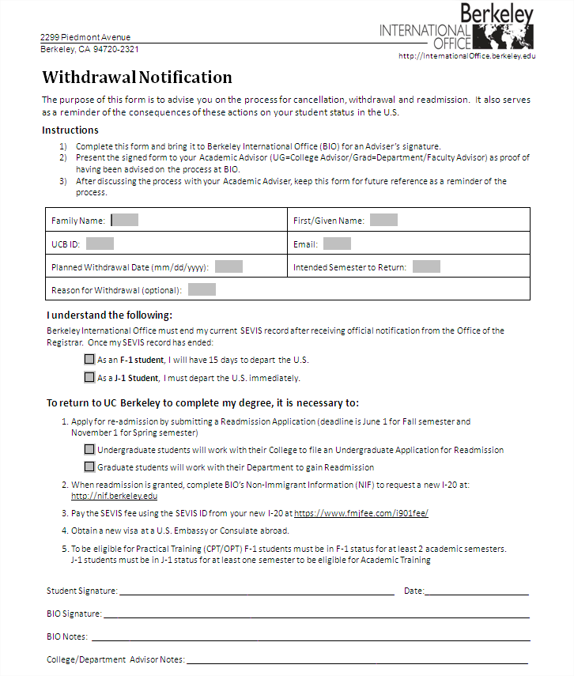
Withdrawal

Slide 45
Other Student Requests

Slide 46
Other Student Requests
Guarantee of Financial Support from department
Change of Degree Level
Visa support letters for students
Letters of invitation for students’ family members
Notes:
Not necessarily forms, but also things that they might encounter.

Slide 47
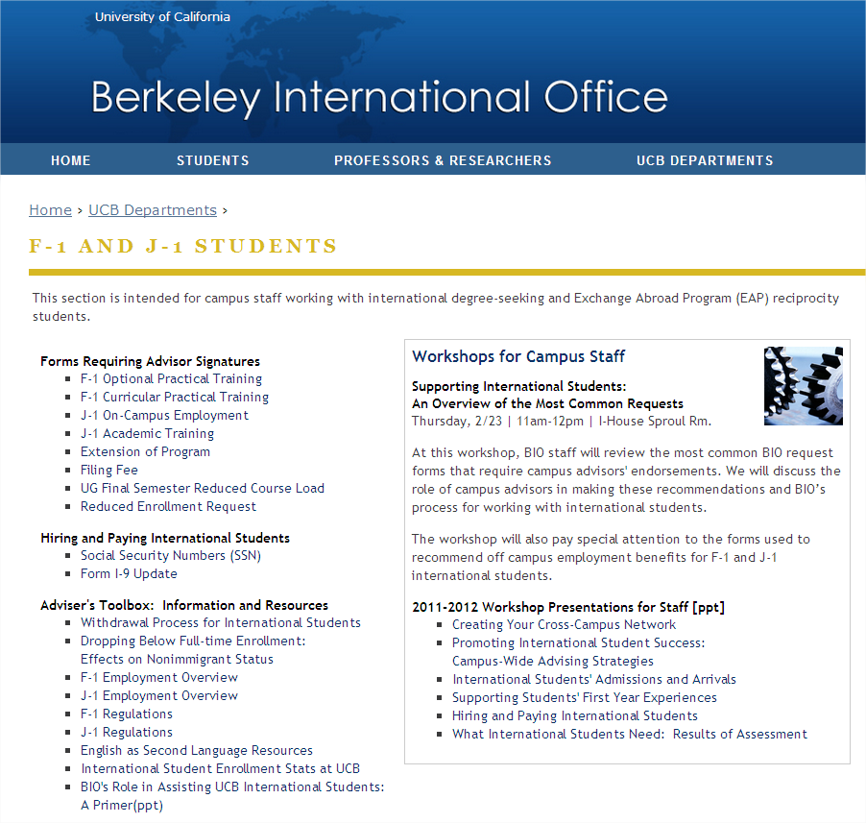
http://internationaloffice.berkeley.edu/ucb_departments/fj_students

Slide 48
Up Next…
Supporting International Student Transitions: Stories from Fall 2011 New International Students
    March 28, 2012
    10:30am-12
    I-House Sproul Rooms

Slide 49
questions?

