Slide 1
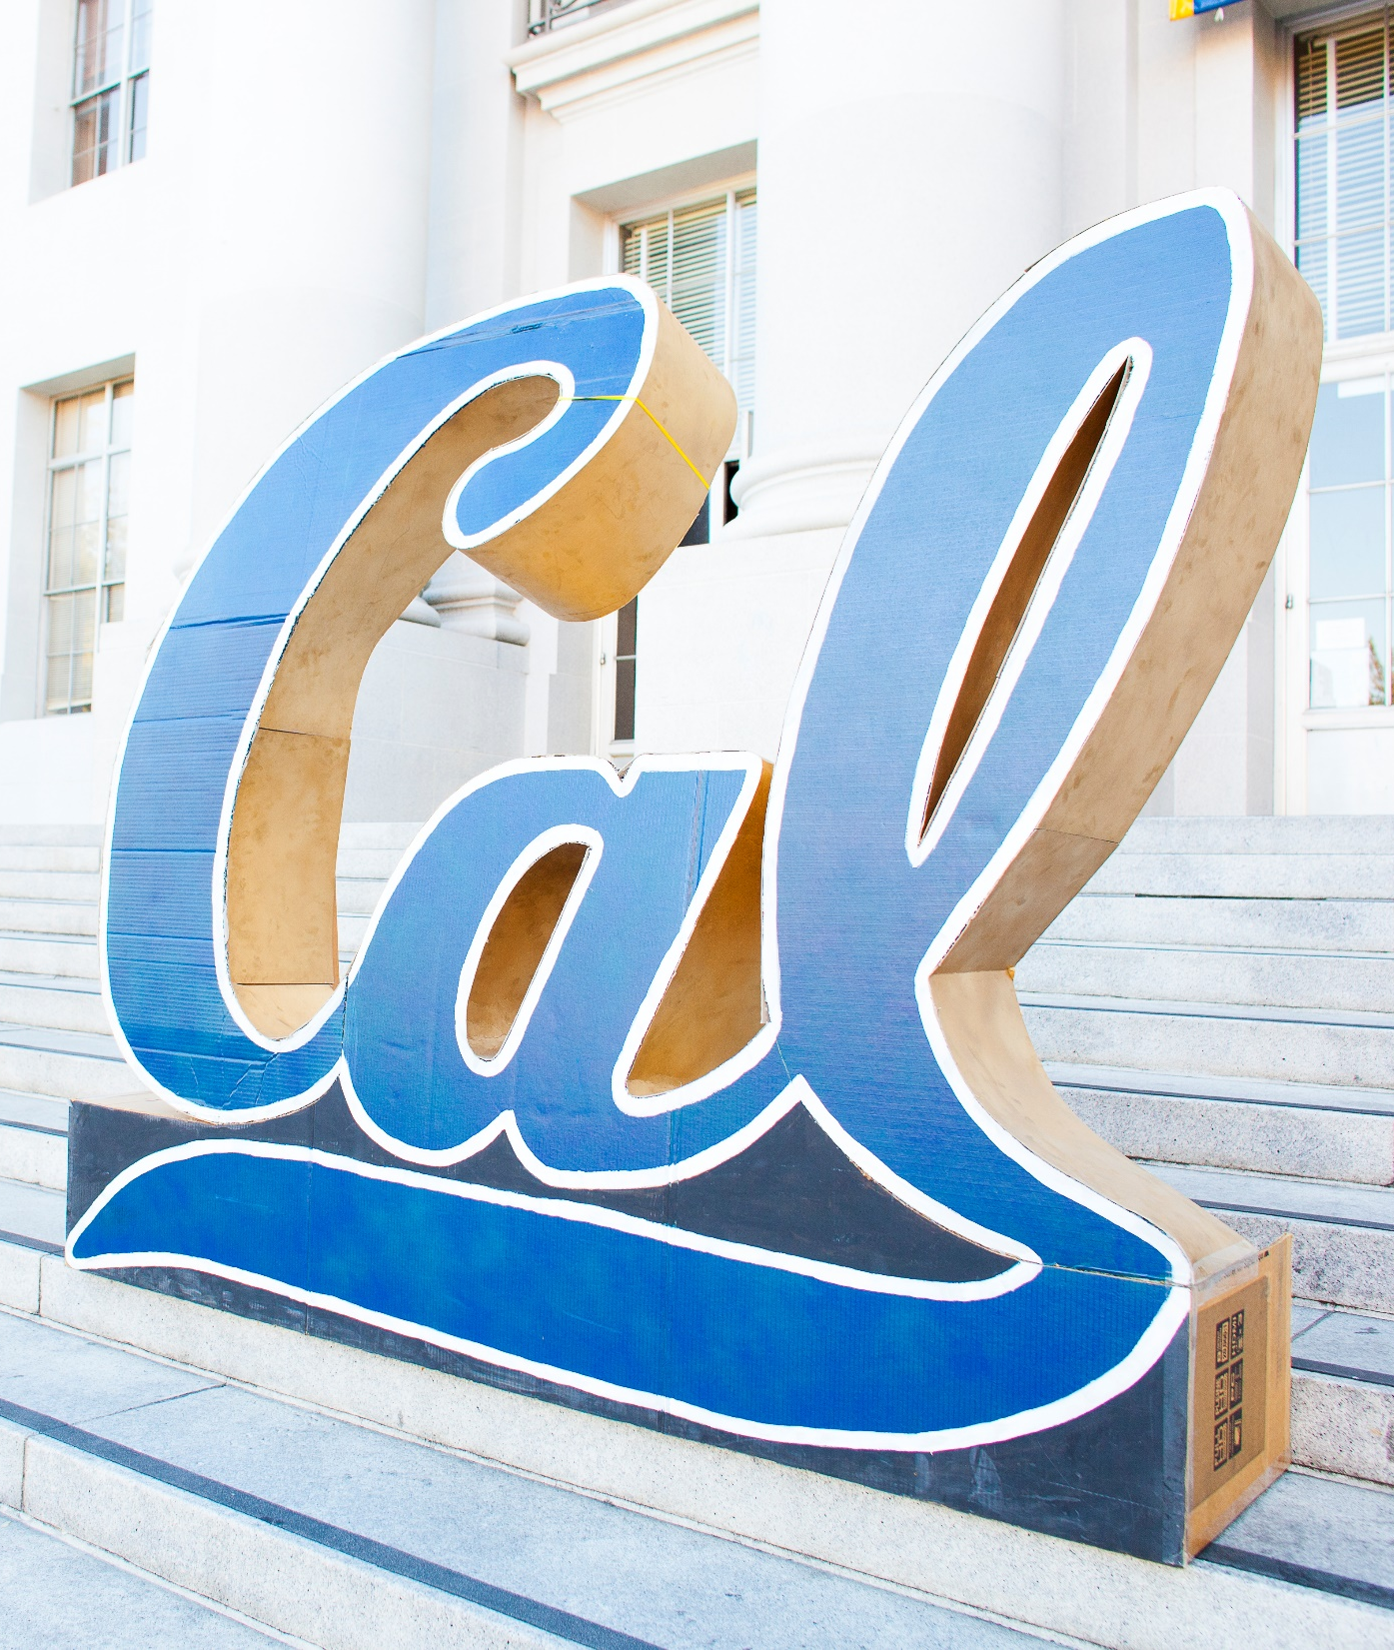
Immigration, Post Completion
& Career

Slide 2
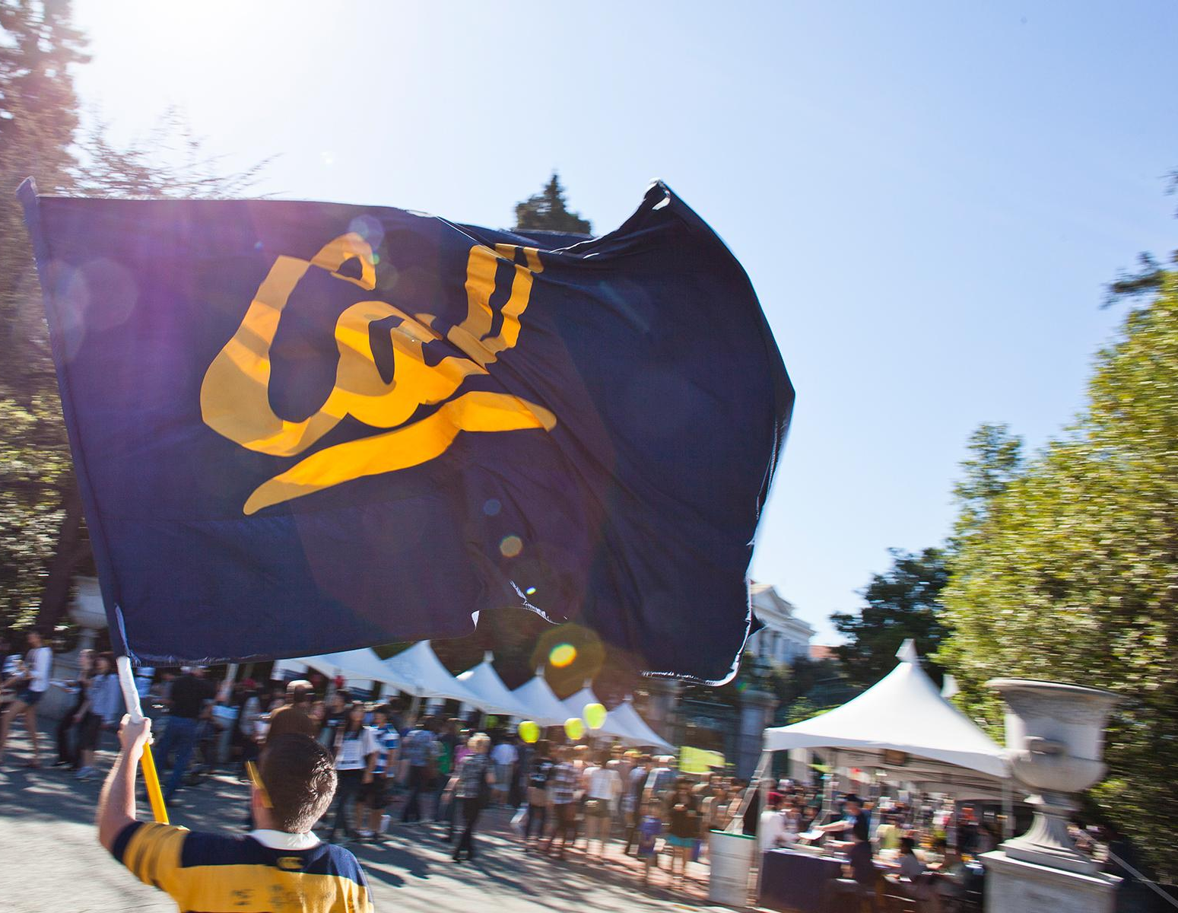
Introduction
Erin Skelly - Lead Adviser for Graduate Student Services & Regulatory Practice
Amy Chin-Pokhrel - International Student Advisor

Slide 3
First year
Notes:
As you begin your first year at Cal as an international student, here are some things you need to be aware of:

Slide 4
Complete your Arrival Confirmation
Notes:
First of all, you will need to complete your arrival confirmation in order for us to activate your immigration record.

Slide 5
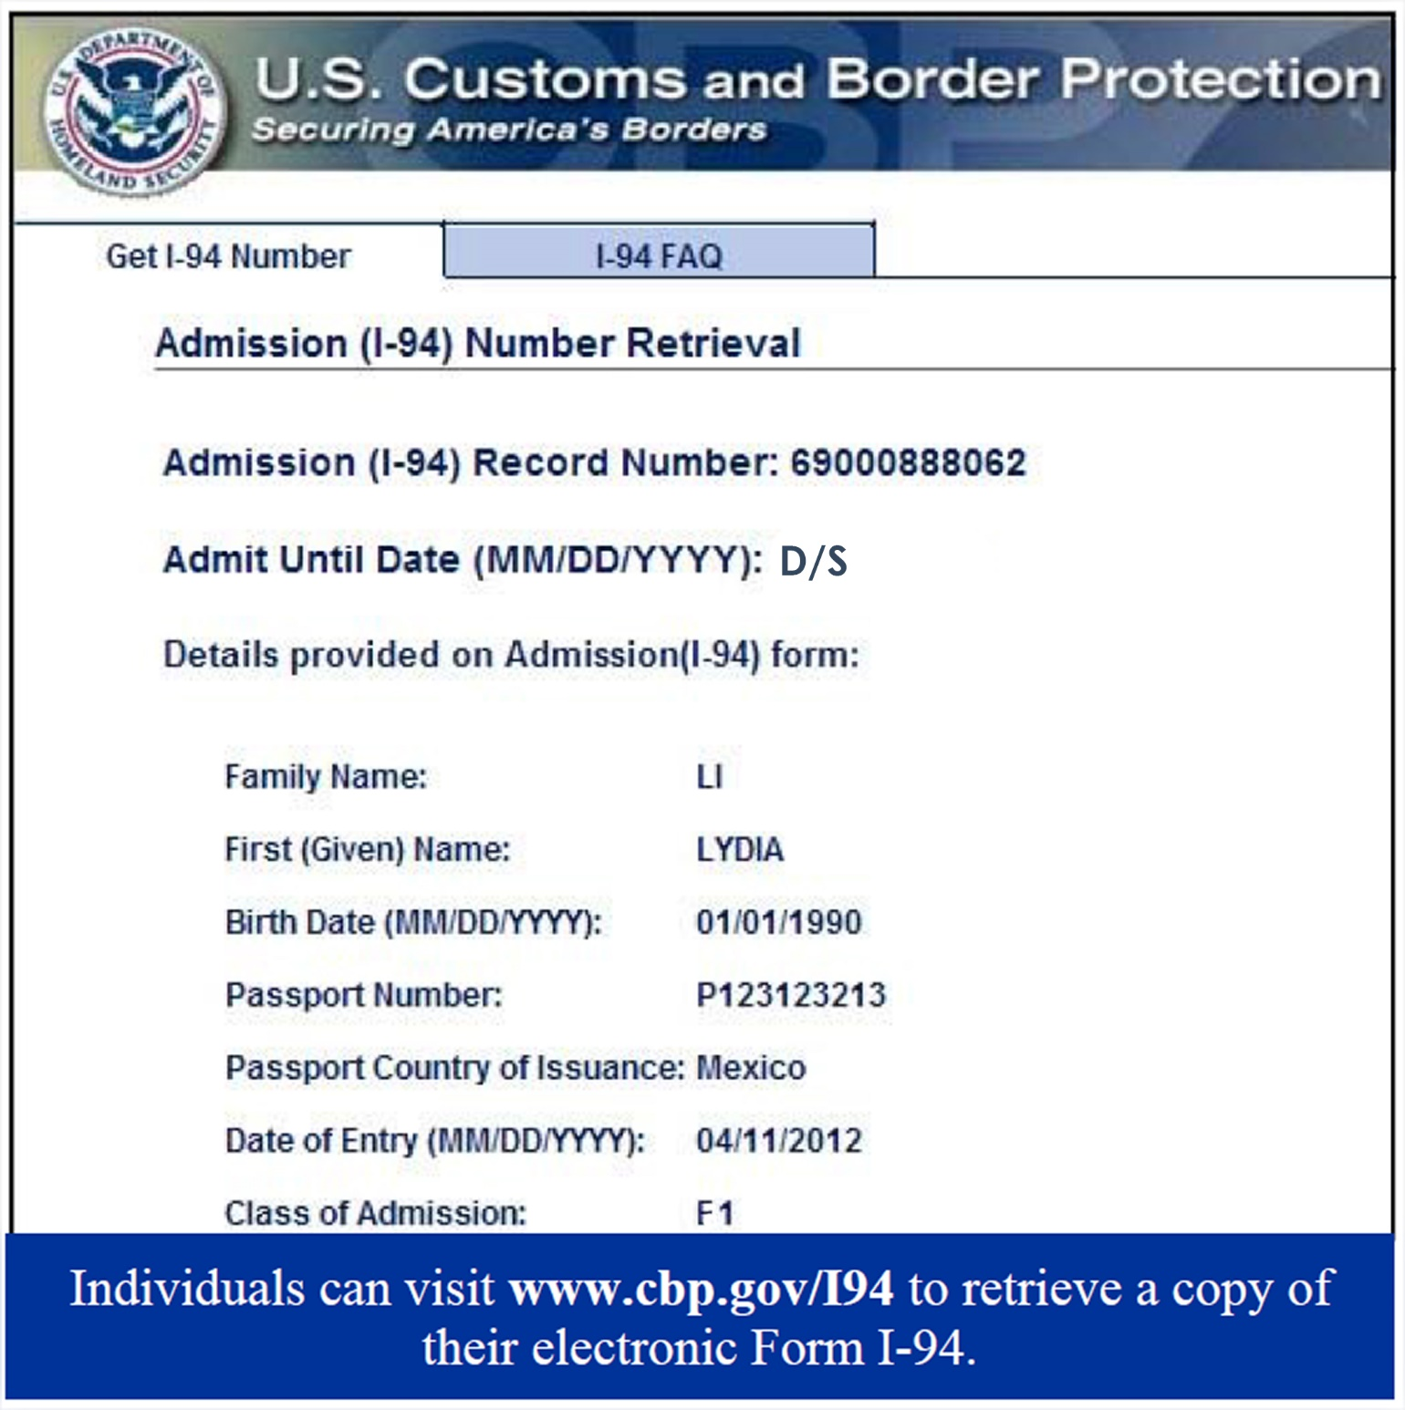
Go to calcentral.berkeley.edu
Upload your I-94
2. Update your Address
Temporary addresses are ok. Remember to update again when you find permanent housing.
If you move or change your email, make these updates within 10 days.
Notes:
In order to do so, you should be seeing a task in your Cal Central. Go ahead and upload your most recent I-94 (make sure the status shows F-1), and update your local Berkeley address! If you’re staying at a hotel temporarily, or somewhere for a short period of time, still go ahead and update this address. Once you move, be sure to change it within 10 days!

Slide 6
Enroll Full Time
Notes:
The other thing which is important for international students to know is that you need to be enrolled full-time.

Slide 7
Full time enrollment is determined by your academic department.
Most academic departments require 12 units each semester.
Most academic departments require
12 units each semester.
Summer ?
College of Letters & Science requires 13units
Notes:
So what constitutes as full-time? Immigration regulations define full-time enrollment as 12 units. However, for UC Berkeley’s purposes, full-time enrollment is determined by your academic department. For example, College of Letters & Sciences define full-time enrollment as 13 units, therefore you will need to have 13 units enrolled to be considered as maintaining your visa status. Students also have questions about the summer session. Unless it is your final semester, summer is optional and is considered an annual vacation. You may take no credits at all, or if you’re ambitious, could take a few courses to be ahead of your peers. However, just be cautious that summer classes are intensive as you’re packing in 1 semester’s worth of learning into a short period of time.

Slide 8
Go to kahoot.it
Input Game PIN
Notes:
Q 1 & 2 Before we move on to our next stage, a short quiz time! (a taste of competitiveness at UC Berkeley :) )

Slide 9
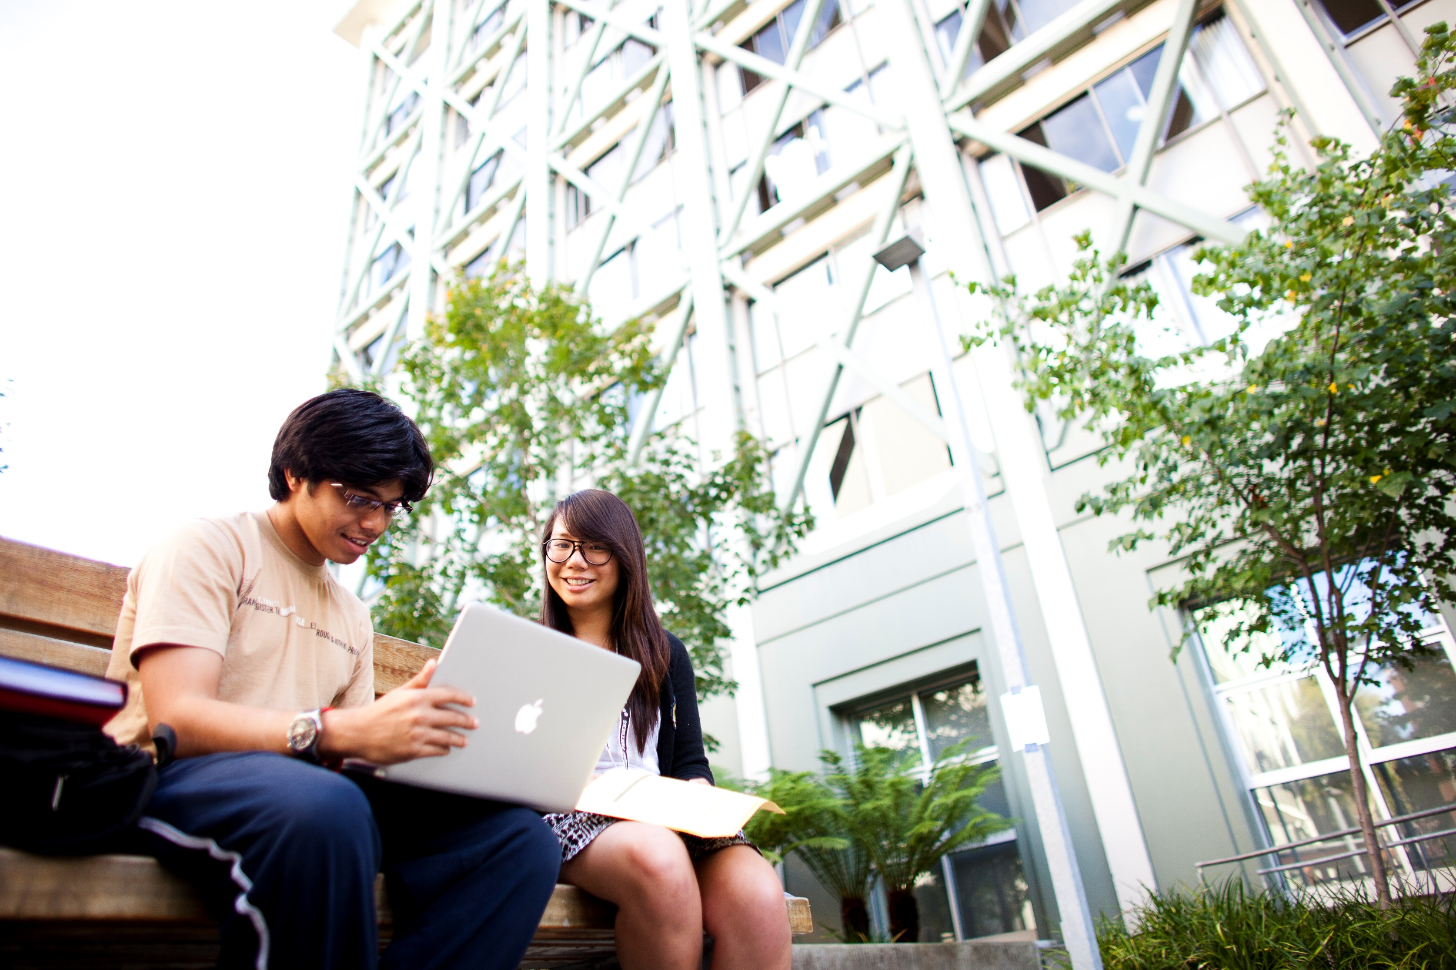
Continuing Student
Notes:
As you transition into your second year, here are more regulations you need to be aware of.

Slide 10
Reduced Course Load
Academic Reasons
Medical Reasons
Final Semester
Approval from a BIO Advisor is required.
Notify BIO if you plan to drop below full time enrollment, withdraw, or cancel.
Notes:
There may be a few circumstances that allows a student to go below the full time enrollment requirement:
First, for academic reasons such as language difficulty, or improper placement of course. Secondly, if you fall ill and are not able to attend classes or be the best student.
Third, it is your final semester and you only have those units left to take.
In all of these cases, you will need to speak to your academic advisor, as well as get an approval from BIO before going below full-time enrollment. If you don’t let us know, you may jeopardize your visa status.

Slide 11
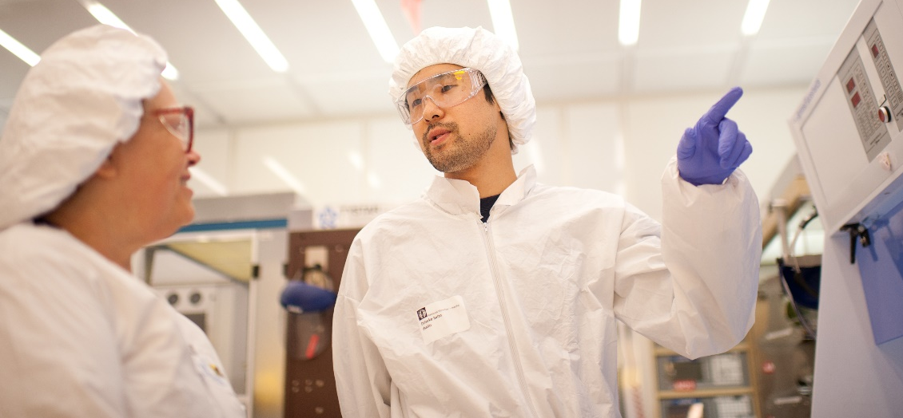
Employment
Notes:
Another hot topic is employment

Slide 12
F- 1 Visa
J- 1 Visa
No special permission required
Permission from BIO required before beginning employment.
On campus employment
20
20
Fall and Spring
<
>
Summer/Vacation
Fall and Spring
<
>
Summer/Vacation
Permission from BIO or USCIS required before beginning employment.
Permission from BIO required before beginning employment.
Off campus employment
Curricular Practical Training (CPT)
Academic Training
Optional Practical Training (OPT)
Notes:
Most students want to know how can they earn extra income or gain professional experience.
For F-1 students, you are able to work on-campus during the academic semester up to 20 hours a week. If it’s during the vacation period, you’re able to work more than 20 hours a week. There is no need to ask for permission as it is a benefit of the F-1 visa status. However, for F-1 students who wish to work off-campus, there are two options: CPT and OPT. These two options have requirements that you have to satisfy prior to approval. Please consult a BIO advisor prior to beginning your employment. Moving on to J-1 visa students, you are able to work on campus up to 20 hours a week during the academic semester. If it’s during the vacation period, you’re able to work more than 20 hours a week. The only difference for you is that you will need to get BIO’s approval prior to beginning work. Same goes for Off-campus employment which is called Academic Training. There are requirements that you will need to satisfy before we can approve you for this. Please consult a BIO advisor. If you are not sure if you’re able to work for a certain employment, please come and see us anyway. It is better to be safe than to jeopardize your visa status!.

Slide 13
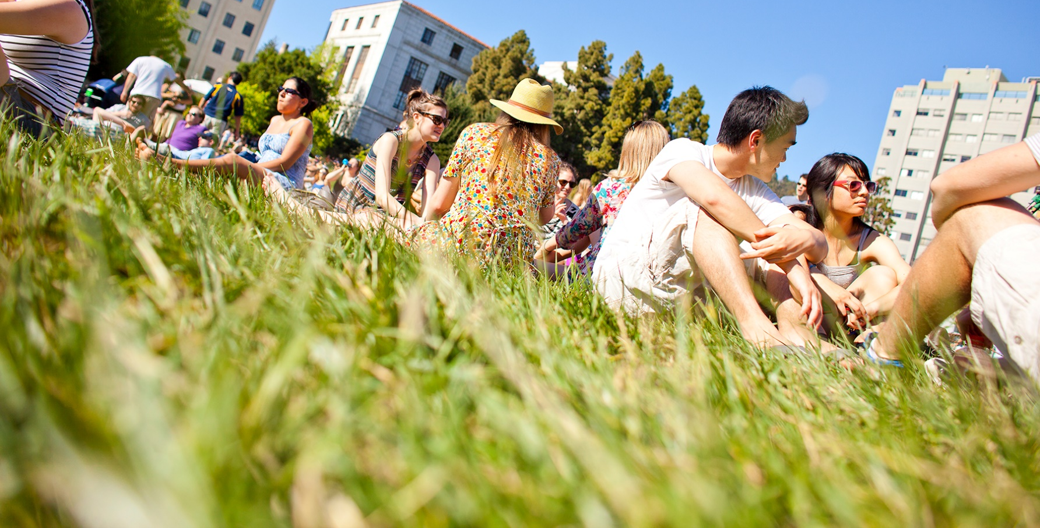
Extra Curricular Activities

Slide 14
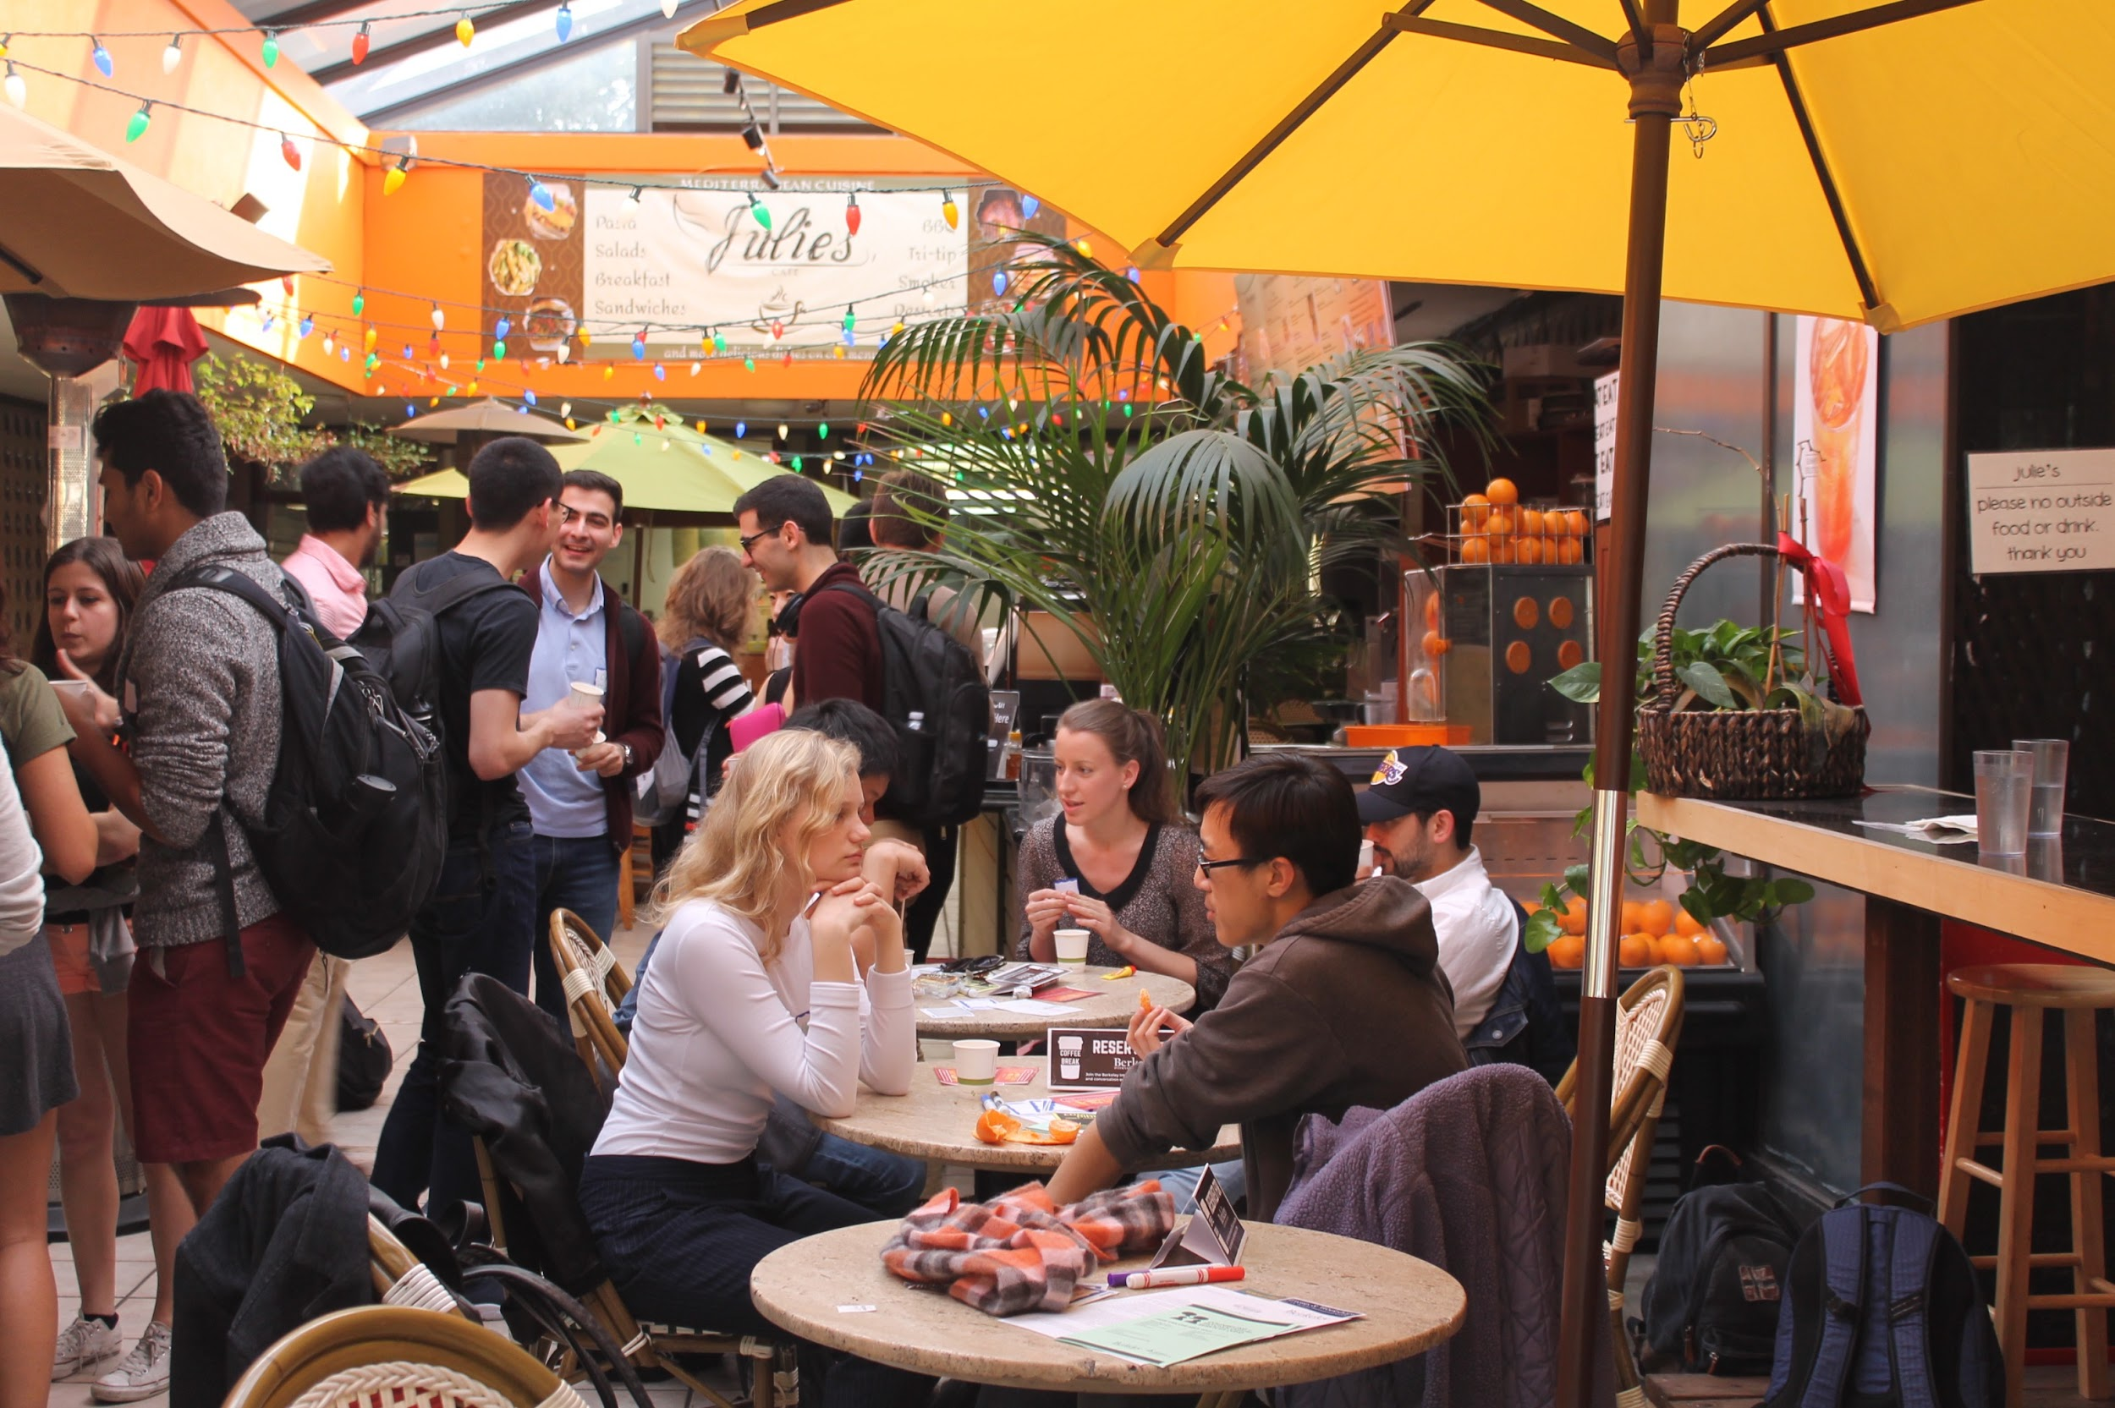
Extra Curricular Activities are a great way to meet others and have fun.

Slide 15
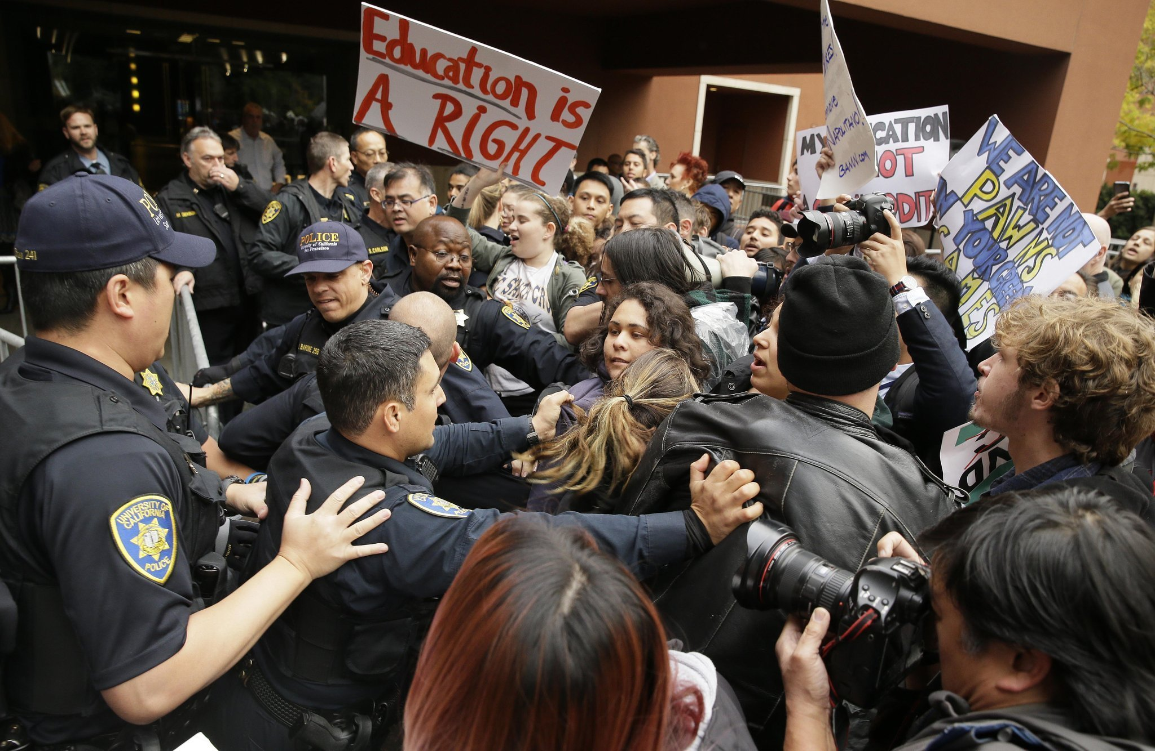
Activities that you engage in on & off campus can impact your visa status

Slide 16
Visa Rules
CA Laws
Just because it’s legal in California…..
Does not mean it’s OK while you’re on a visa.

Slide 17
The legal drinking age in the U.S is
21
Notes:
Fake IDs

Slide 18
Contact BIO as soon as possible if you have an encounter with law enforcement

Slide 19
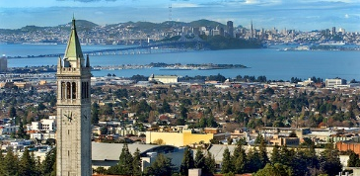
Travel

Slide 20
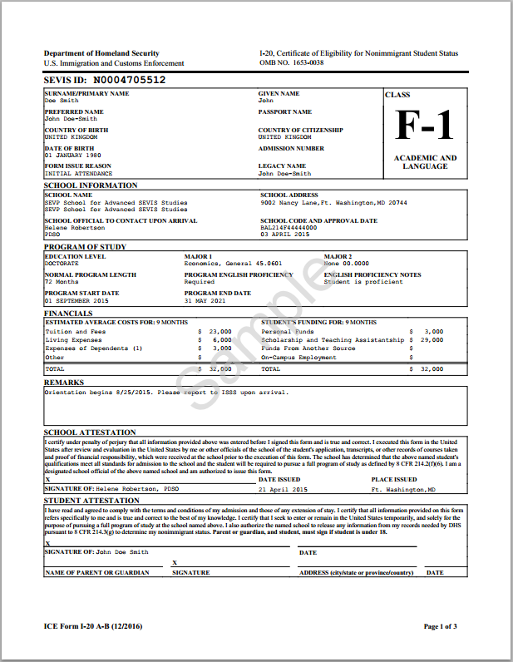
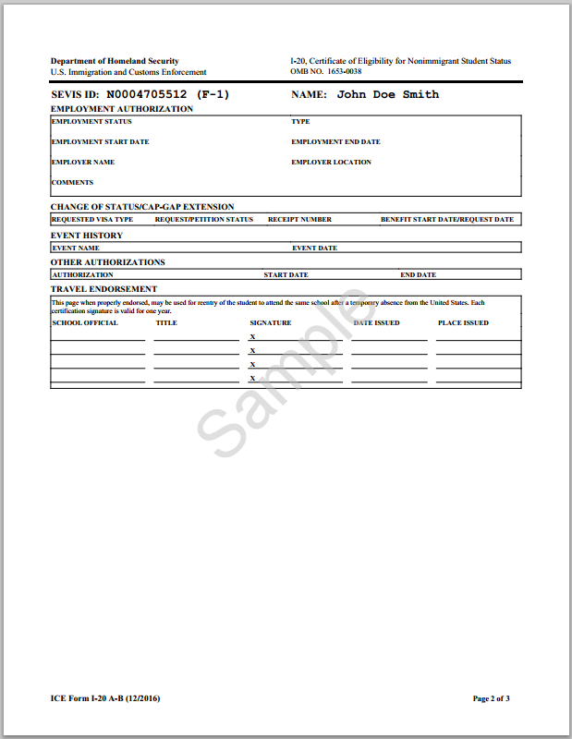
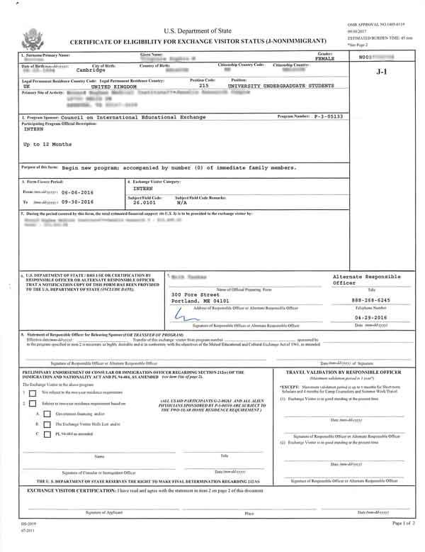
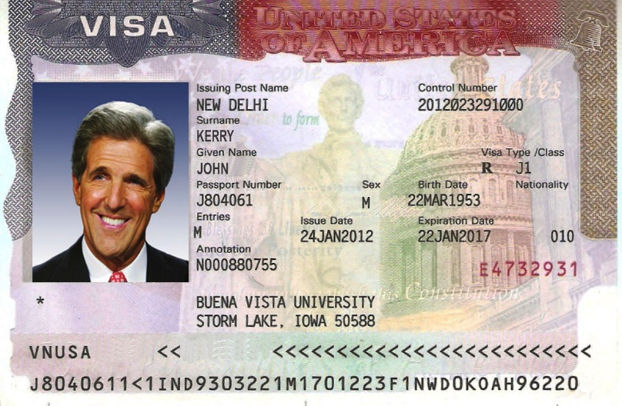
DRAFT
School Official
School Official

Slide 21
Go to kahoot.it
Input Game PIN
Notes:
Q 3,4,5,

Slide 22
Senior & Graduates

Slide 23
DRAFT
I-20
DS-2019
Request a program extension before your I-20 or DS-2019 expires if you need additional time to complete your program.

Slide 24
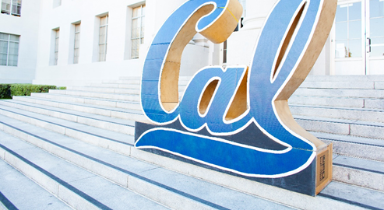
Communication from BIO
Notes:
coming up towards graduation, here is what you may need to pay attention to. Add emphasis on paying attention to BIO emails, because that is where relevant information will be.

Slide 25
Depart the U.S
Grace Period
F: 60 days
J: 30 days
Transfer to a different institution or change level of study
F: 60 days
J: 30 days
Graduation
Grace Period
Final semester: talk to your BIO advisor
Apply for OPT/AT or explore employment options

Slide 26
Go to kahoot.it
Input Game PIN
Notes:
Q 6

Slide 27
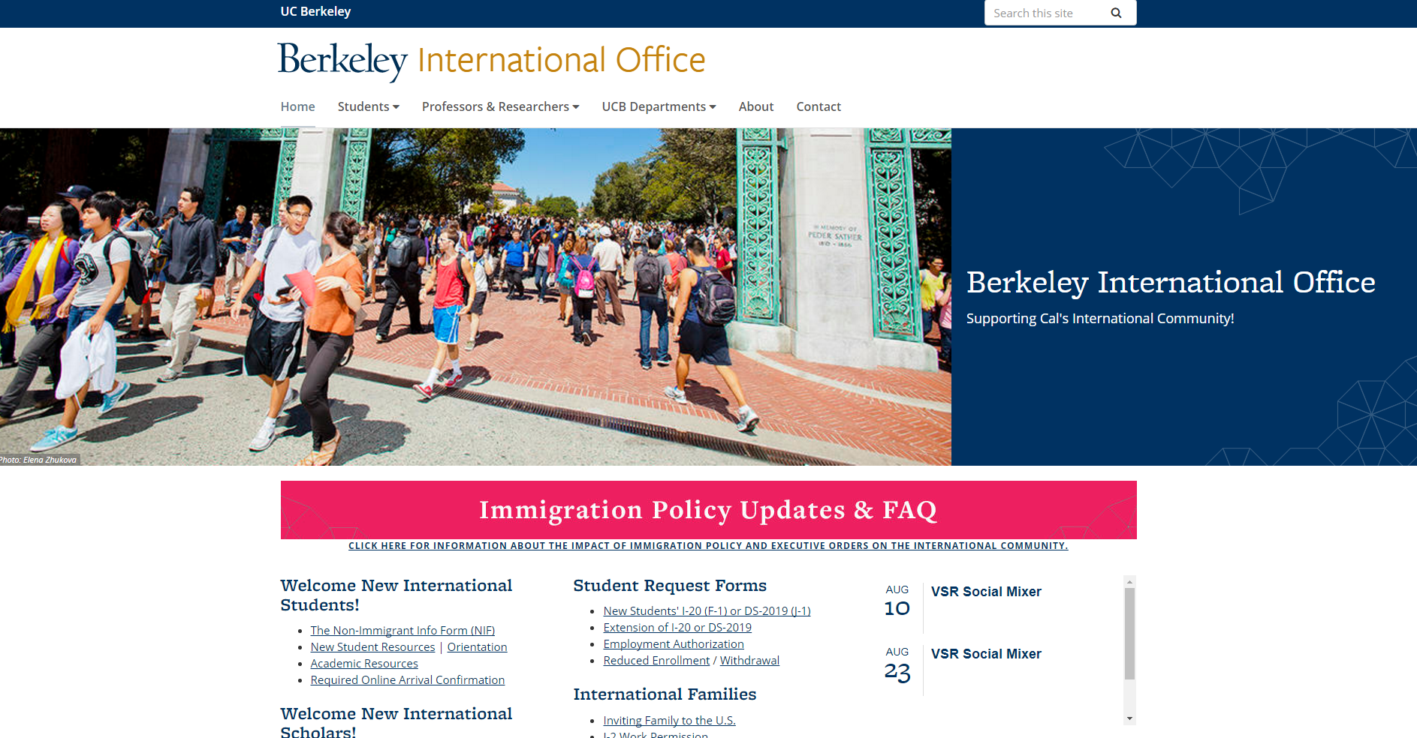
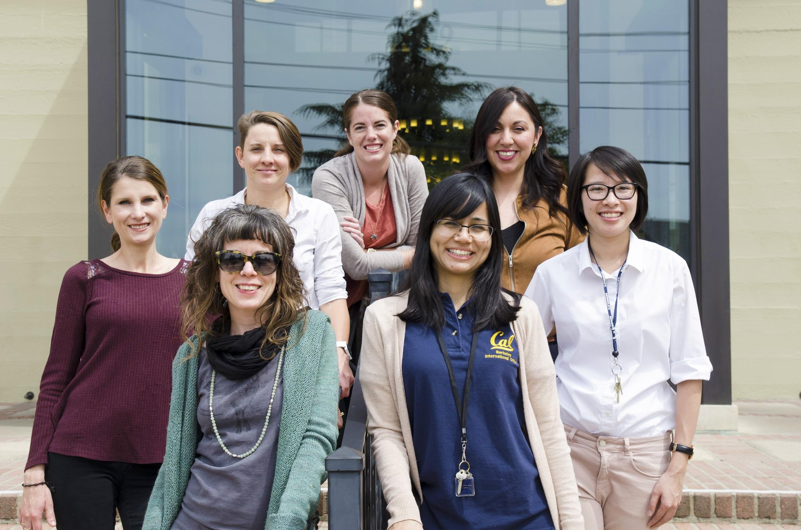
Resources
http://internationaloffice.berkeley.edu/
Email: internationaloffice@berkeley.edu
Open Hours: Mon., Tues., Wed., Thur. & Fri.
9am - 12pm and 1pm - 4pm
Phone: 510.642.2818
Notes:
They should have seen all this information in Golden Bear Prep, so remind them that they can refer back to it for more information.

